Slide 1
Cash Book Application
A Digital Finance Management Tool Prepared by: AHMED NAAEM SAAD (23SP-006-CS) ILSA KHAN (23SP-010-CS) FARAZEEN SABIR (23SP-020-CS) IKTISAB AHMED (23SP-035-CS) SUFYAN YASIN (23SP-036-CS)

Slide 2
Introduction
What is the Cash Book Application?
A user-friendly application that tracks daily income and expenses.Provides users with a clear overview of their financial status by recording each transaction.Categorizes transactions into groups like Food, Rent, Salary, Bills, etc.Allows users to view their financial data in the form of reports.Includes a feature to export data in CSV format for further analysis in Excel or other spreadsheet tools.

Slide 3
Problem Statement
Traditional manual cash books are time-consuming and prone to errors.
Maintaining a proper transaction record is difficult.
Creating financial reports manually is tedious.
Individuals and small businesses need a system that can easily manage daily transactions and provide a financial overview.
Manual data entry increases the chances of data loss and calculation errors, which affects sound financial decision-making.

Slide 4
Application objectives
Accurately maintain a daily record of income and expenses.
Organize transactions under different categories.
1
2
Generate financial reports such as monthly summaries and expense distributions.
Export data in CSV format for compatibility with Excel.
3
4
Design a simple and interactive GUI so users can easily add/edit entries.
Ensure the application is secure, reliable, and scalable.
5
6

Slide 5


Technologies Used
Programming Language: Java
Libraries & Tools:
Swing Library: Used for designing the Graphical User Interface (GUI) including buttons, forms, tables, etc.
Apache POI: For exporting and importing Excel and CSV files.
Visual Studio code: IDEs for development.
JDK 11+: Java Development Kit.

Slide 6
Features & User Actions
Add Receipt: Enter daily income with amount, date, and category.
Add Payment: Enter daily expenses.
View Transactions: View the complete transaction list with options to filter by date, category, etc.
Export to CSV: Export financial data for analysis in Excel.Summary

Slide 7
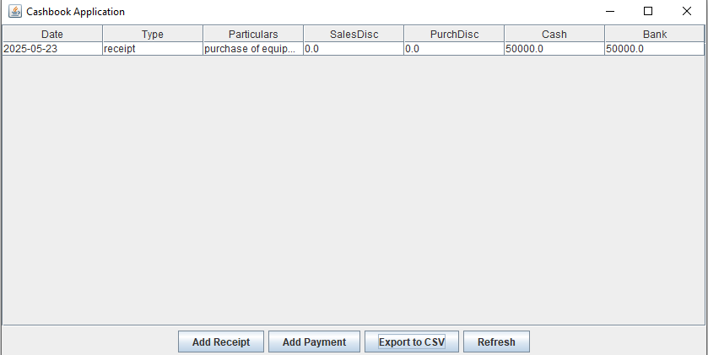
GUI Overview
Clean and simple design with clearly visible options:
Add Receipt,
Add Payment,
Export Data.
A transaction table displaying all entries with columns like Date, Description, Amount, Category, Type.Buttons for editing or deleting entries.
Export button for generating CSV files.

Slide 8
Conclusion & Future Scope
Conclusion & Future Scope
This application simplifies the task of maintaining daily financial records.
It is especially useful for students, small business owners, and general users.
Improves data accuracy and saves time.In the future, mobile app development, cloud synchronization, advanced analytics, and budgeting features can be added.
Continuous improvement can be made based on user feedback.

Slide 9
THANK YOU..!!

